Slide 1

Green Computing
By
Dr. Saurabh Singhal
Associate Professor
Department of Computer Engineering & Applications
GLA University

Slide 2
Green Computing
Green computing is the environmentally responsible and eco-friendly use of computers and their resources.
In broader terms, it is also defined as the study of designing, manufacturing or engineering, using and disposing of computing devices in a way that reduces their environmental impact.
Green Cloud computing is envisioned to achieve not only efficient processing and utilization of computing infrastructure, but also minimize energy consumption.

Slide 3
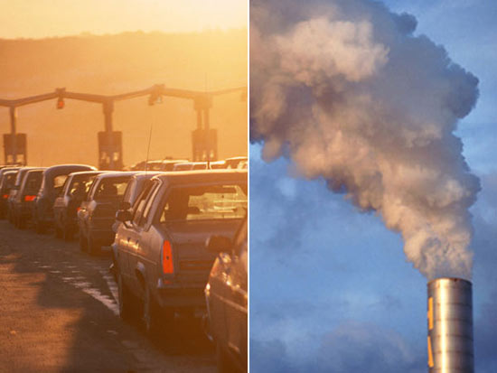
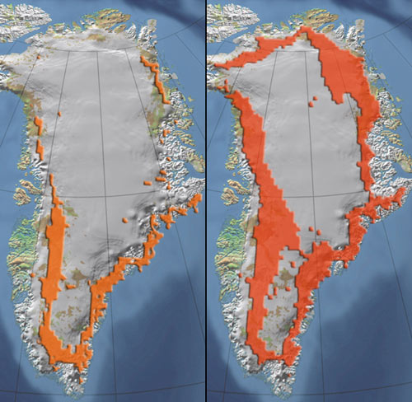
Dark side of Cloud
Gartner Report 2007: IT industry contributes 2% of world's total CO2 emissions
U.S. EPA Report 2007: 1.5% of total U.S. power consumption used by data centers which has more than doubled since 2000 and costs $4.5 billion
Solution: Green Computing

Slide 4
Why is green computing needed in cloud?
Cloud Data Centers consume excessive amount of energy:
According to a report on “Revolutionizing Data Center Energy Efficiency” :
A typical data center consumes as much energy as 25,000 households.
The total energy bill for data centers in 2010 was over $11 billion and energy costs in a typical data center doubles every five years.

Slide 5
Clouds Impact on the Environment
Data centers are not only expensive to maintain, but also unfriendly to the environment.
Carbon emission due to Data Centers worldwide is now more than both Argentina and the Netherlands emission.
High energy costs and huge carbon footprints are incurred due to the massive amount of electricity needed to power and cool the numerous servers hosted in these data centers.

Slide 6
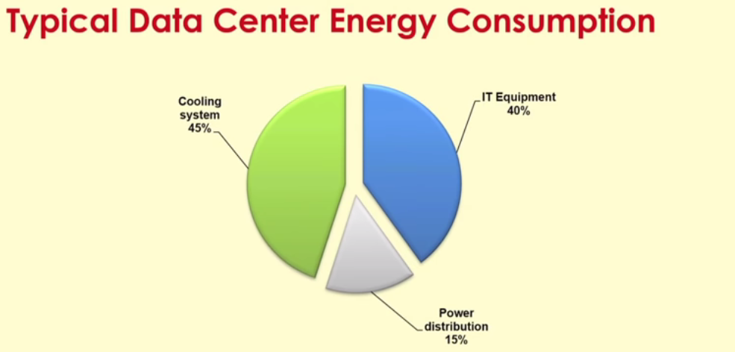
Clouds Impact on the Environment

Slide 7
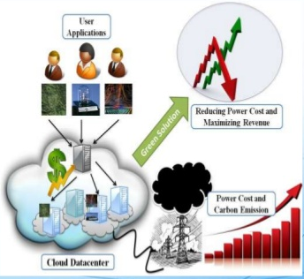
Clouds Impact on the Environment
As energy costs are increasing while availability decreases, there is a need to shift focus from optimising data center resource management for pure performance alone to optimising for energy efficiency while maintaining high service level performance.

Slide 8
Cloud Providers Measures
Cloud service providers need to adopt measures to ensure that their profit margin is not dramatically reduced due to high energy costs.
Amazon.com’s estimate the energy-related costs of its data centers amount to 42% of the total budget that include both direct power consumption and the cooling infrastructure amortized over a 15-year period.
Google, Microsoft, and Yahoo are building large data centers in barren desert land surrounding the Columbia River, USA to exploit cheap hydroelectric power.

Slide 9
Green Cloud Computing Architecture

Slide 10
Green Broker
A typical Cloud broker
Lease Cloud services
Schedule applications
Green Broker
1st layer: Analyze user requirements
2nd layer: Calculates cost and carbon footprint of services
3rd layer: Carbon aware scheduling

Slide 11
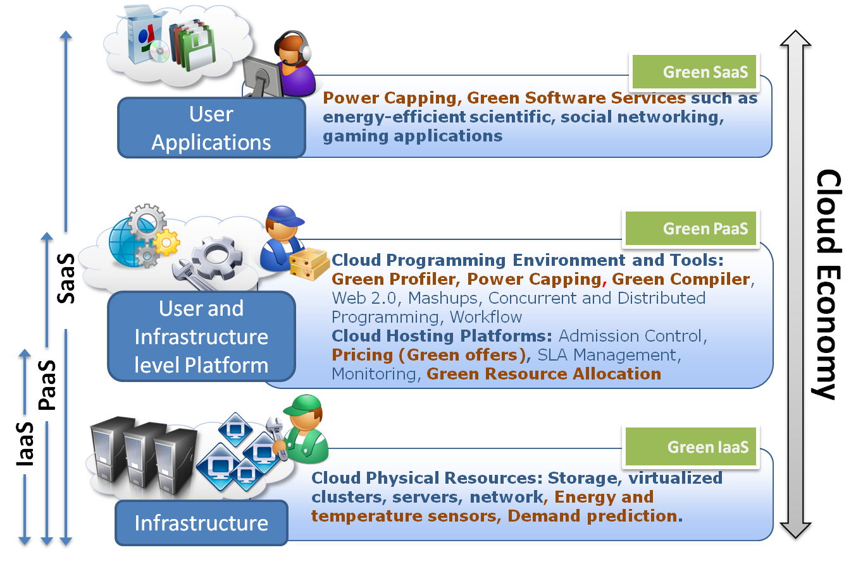
Provider: Green Middleware

Slide 12
PUE and CUE
PUE Definition
Overall Power Drawn by the facility divided by the Power Delivered to the Data Centers.
PUE relates the total consumption of the installation with that considered essential to the service: the computer servers(IT Load).
It is the responsibility of the IT manager to reduce the consumption of IT load (renewing servers, virtualizing, etc.), and the responsibility of the infrastructure manager to reduce the auxiliary consumption (more efficient equipment, free-cooling, etc.)
CUE –Carbon Usage Effectiveness
CUE defines CO2 emissions associated with the DC losses

Slide 13
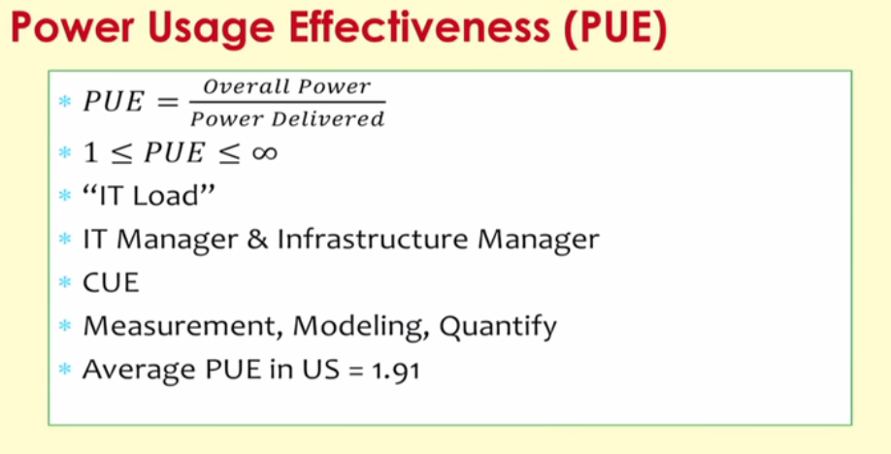
PUE and CUE

